Slide 3
Were
were
Was
wasn’t
was
were
was
was
was
Were
weren’t
was
was

Slide 4
was
was
were
were
wasn’t
was
were
Was

Slide 5
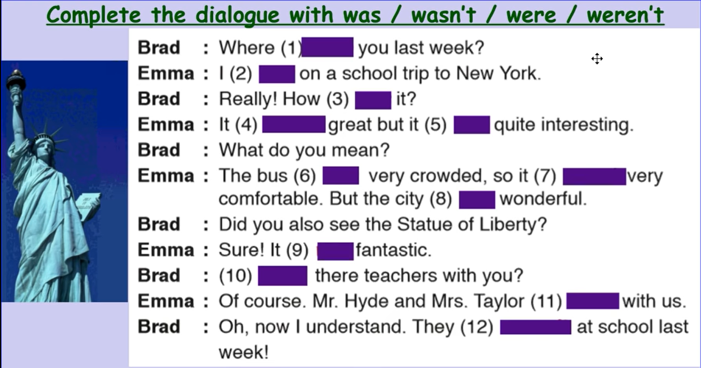
were
was
was
wasn’t
was
was
wasn’t
was
Were
was
were
weren’t

Slide 11
She visited the old town 10 years ago.
I didn’t plan a trip last summer.
I didn’t listen to end of the history.
You studied for the history exam yesterday.
The quenn wanted a tomb for husband in 353 BC.

Slide 12
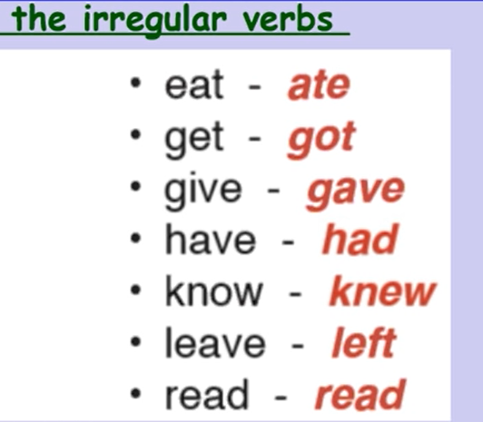

Slide 13
She visited the historical sites in the city.
Did the group leave the Great Wall early?
We didn’t give our tickets to the ticket collector.
Did the students understand the history of the Pyramids?
The teacher wrote the names of the group members.

Slide 14
forgot
was
took off
did
sleep
ran
Did
stay
were
saw
washed
came

Slide 15
went
was
wanted
was
planned
started
found
didn’t have
bought
didn’t book
learned/learnt
arrived
felt
were
helped

Slide 16
got
discovered
didn’t see
finished
died
looked
left
missed
did
have

Slide 19
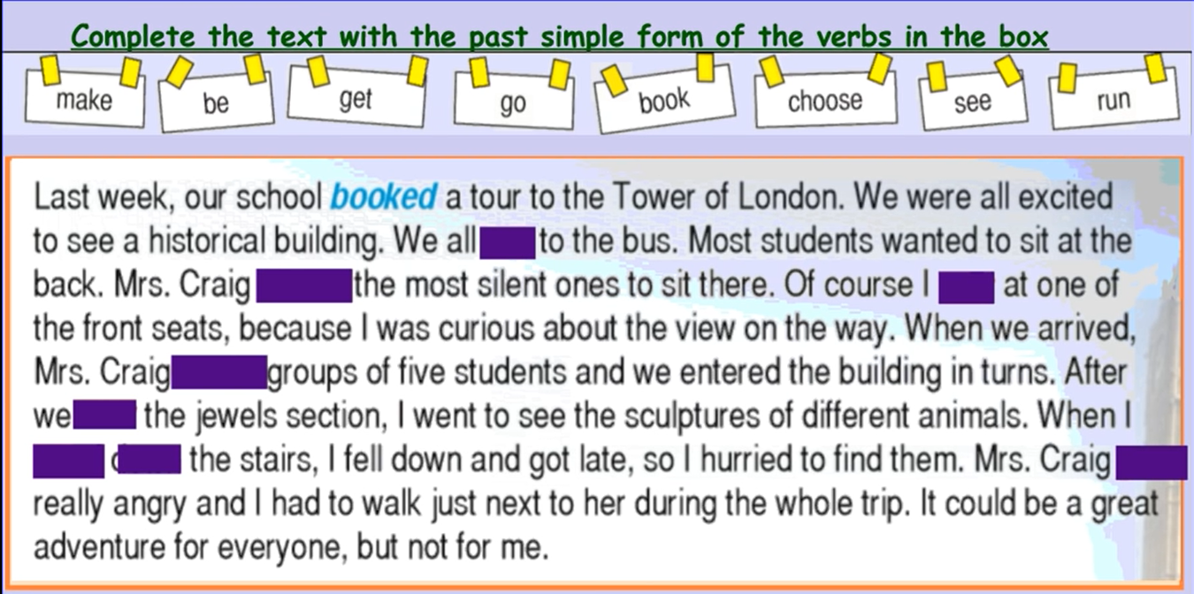
ran
chose
was
made
saw
went
down
got

Slide 20
sat at the back of the bus
Did they see
Why was the girl
Was the trip

